Slide 1
Blood Clot and Pulmonary Embolism Policy (BCPEP)
September 18, 2024
This meeting is being recorded

Slide 2
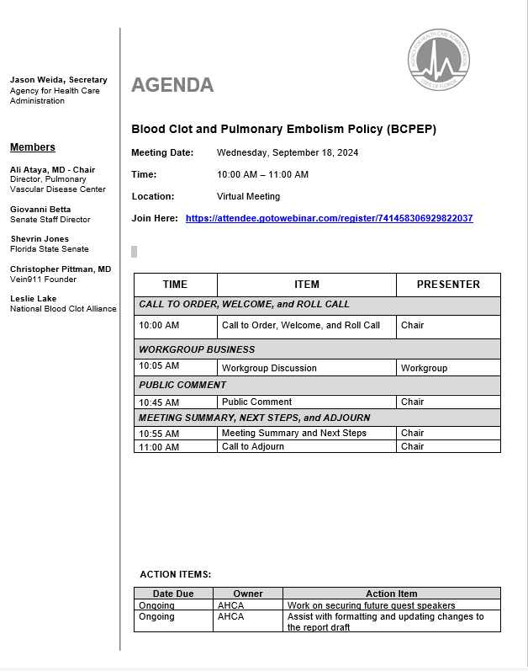

Slide 3
Call to Order, Welcome, and Roll Call

Slide 4
BCPEP POLICY
REPORT REVIEW

Slide 5
Workgroup Discussion

Slide 6
Public Comments

Slide 7
Meeting Summary

Slide 8
Next Steps

Slide 9
Adjournment

Slide 10
THANK YOU

